Slide 1
Why Many People Believe the US Is Still in Recession. But It Is Not! Southwest Ideas Conference Dallas TX November 19, 2014
Harvey Rosenblum
Professor of Business and Financial Economics SMU/Cox School of Business

Slide 2
Why Do So Many People Believe the United States Is Still in Recession?
Midwest Ideas Conference
Chicago Illinois
August 26, 2014
Harvey Rosenblum
Professor of Business and Financial Economics
SMU Cox School of Business

Slide 3
Overview of U.S. Economy: August 2014
Weakest economic recovery in generations
Avoided another Great Depression
Five years of healing, but not healed
Poised for return to semblance of normality; but when?

Slide 4
How Bad Was It?
Peak
Current Cycle
2005 Q4–2013 Q3
11.2% below average of prior cycles in 2013 Q3
Average of
Prior Cycles
NOTE: The grey area indicates the range of the major recessions since 1960, excluding the short 1980 recession.
SOURCE: Concept from Atkinson, Tyler, David Luttrell, and Harvey Rosenblum, “How Bad Was It? The Costs and Consequences of the 2007-09 Financial Crisis,” Federal Reserve Bank of Dallas, Staff Papers, July 2013.

Slide 5
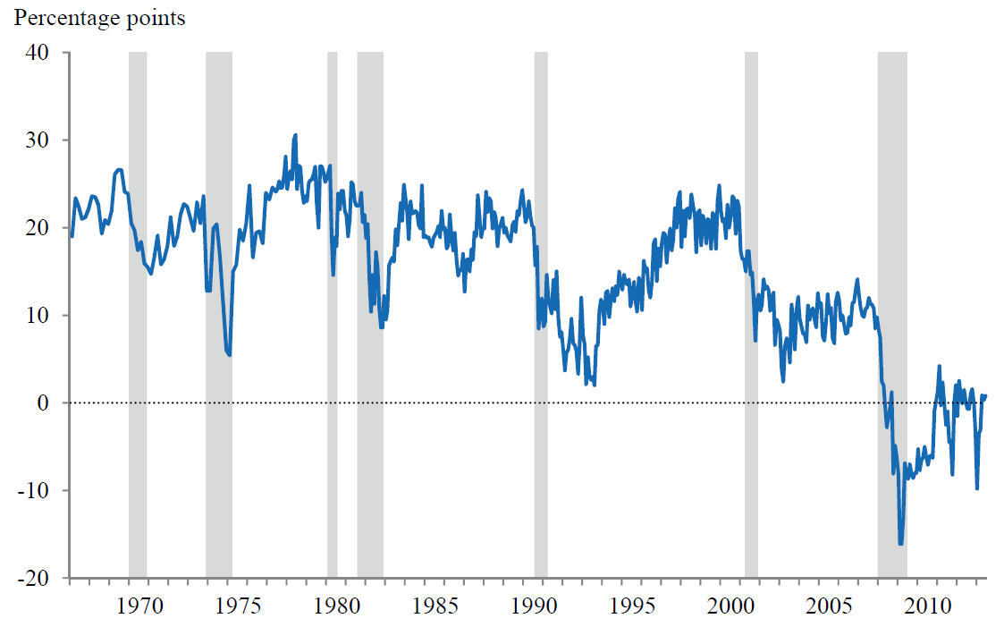
Crisis Dramatically Lowers Income Expectations
Median, Apr ‘03-Apr ‘08: 9.8
Net percent of respondents who expect their income to increase
Median, May ‘08-Aug ‘13: -3.0
SOURCE: Atkinson, Tyler, David Luttrell, and Harvey Rosenblum, “How Bad Was It? The Costs and Consequences of the 2007-09 Financial Crisis,” Federal Reserve Bank of Dallas, Staff Papers, July 2013.

Slide 6
GDP Growth
Post-Recession Average: 2%
Long-run average: 2.8
Q1
2014
SOURCE: Bureau of Economic Analysis.

Slide 7
Employment by Federal Reserve District
Measured by employment, two-thirds of Federal Reserve districts, with 80% of US population, still in recession
Dallas
Minneapolis
New York
Kansas City
Richmond
Boston
Philadelphia
Chicago
St. Louis
Atlanta
San Francisco
Cleveland
SOURCE: Federal Reserve Bank of Dallas.

Slide 8
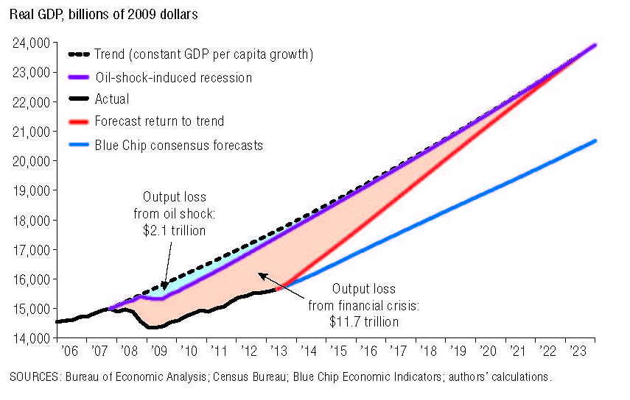
Output Loss Is Large Even with Optimistic Forecast

Slide 9
Different Approaches to Measuring the Crisis’ Cost
A. Looking at Lost Output and Forgone Consumption
 | According to path of output | According to path of consumption
Cost in 2012 dollars | $6 trillion - $14 trillion | $15 trillion - $30 trillion
Percent of 2007 output | 40-90% | 100 – 190%
B. Other Harder-to-Quantify Outcomes
 | National trauma and lost opportunity | Extraordinary government support
Cost in 2012 dollars | Up to $14 trillion | $12 trillion - $13 trillion
Percent of 2007 output | Up to 90% | 80 – 85%
Source: Economic Letter • Federal Reserve Bank of Dallas • September 2013

Slide 10
The Banking Bust 2008-2009
Total $$ of 165 failed Institutions: | $542 BILLON
TOTAL ASSETS OF (essentially 2) ASSISTED BANKS: | $3.22 TRILLION
(failure with a different label)
BANK ASSETS DIRECTLY SUPPORTED ‘08-’09: | $3.8 TRILLION
+ COMMERCIAL BANK ASSETS OF 7 OTHER FIRMS FORCED TO TAKE TARP FUNDS: | $4.0 TRILLION
TOTAL BANKING ASSETS SUPPORTED: | $7.8 TRILLION
~2/3 of the commercial banking industry!

Slide 11
Dodd-Frank Act (“DFA”)
Entrenches, rather than ends, Too-Big-To-Fail
Unworkable and unenforceable due to length, scope, conflicts, and complexity
849 pages of statutes
Over 14,000 pages of proposed regulations, so far
Regulations roughly half completed
Increased government intrusion and weaker market incentives

Slide 12
Dodd-Frank Act (“DFA”) cont.
Next financial crisis will be bigger and be upon us sooner with DFA
Last crisis cost $15-30 Trillion (1-2 years of output)
DFA reinforces perverse incentives
As a nation, we cannot afford to repeat these same avoidable mistakes
DFA reinforces perception of future bailouts
Designates large, complex financial companies as “Systemically Important Financial Institutions” (SIFIs)
Provides taxpayer funds for Debtor-In-Possession financing of bankrupt holding companies and subsidiaries
Perpetuates quasi-nationalization of largest financial institutions as happened in 2008-09

Slide 13
The Situation in Late 2014 – Early 2015
A noticeably improved economy
Can the Fed unwind its massive balance sheet without stifling economic growth?
A healthy banking system is the key

Slide 14
On the Surface, the Banking Industry Seems Healthy
Industry net income: $40.2 billion in 2014 Q2
Charge-Offs at a seven-year low
Noncurrent loan rate at six-year low
Capital has been re-built
98.4% of all banks, holding 99.8% of industry assets, met or exceeded requirements for the highest regulatory capital category
Increase in loan balances, largest since 2007
Bottom line: Profitable, well-capitalized banks are back in the business of lending
Source: FDIC Quarterly Banking Profile, Second Quarter 2014

Slide 15
Banking Industry Health: A Deeper Look
Since 2009: 16% fewer banks
492 failures
Nearly 600 banks lost through consolidation
Virtually zero new bank charters
Lack of demand or lack of supply of charters?
2014 Q2: 354 problem banks ($110 billion assets)
Plenty of existing charters “for sale”
Holding back the demand for bank charters
High and uncertain regulatory burden of Dodd-Frank
Deposit Insurance Fund is under-capitalized
Ultra-low interest rate environment stemming from monetary policy
TBTF entrenched
Capital is NOT flooding into the banking industry

Slide 16
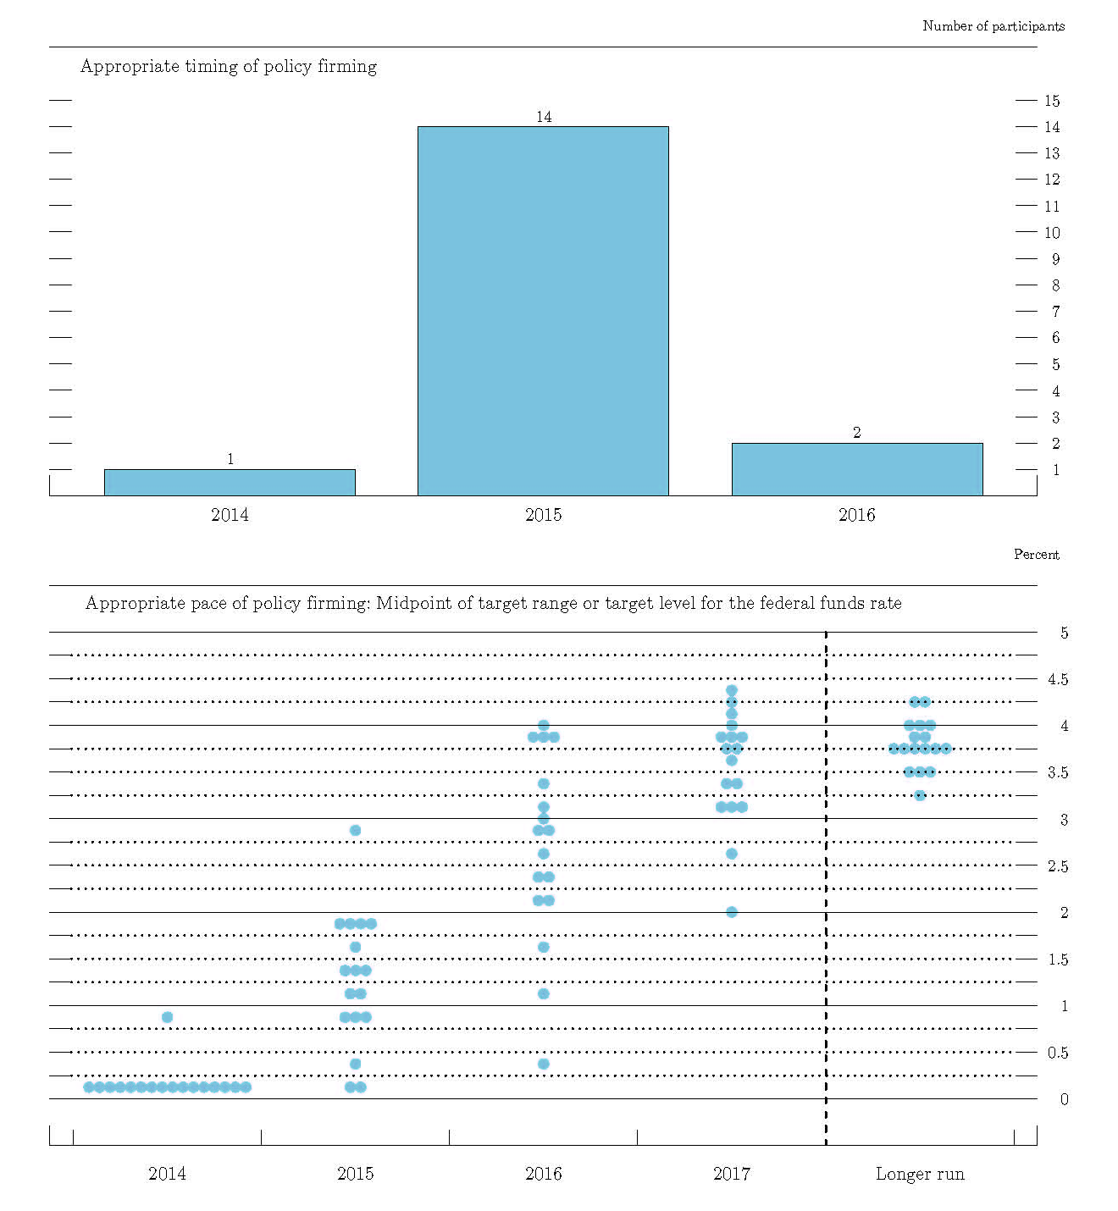
FOMC Views on Fed Funds Rate

Slide 17
Transmission of Quantitative Easing to the Economy

Slide 18
Limited Impact of QE
QE2 added in late 2010
0.13 percentage point to GDP
0.03 percentage point to inflation
Much of this very limited impact depended on commitment to ZIRP for an extended period
In an economy with 2.2% growth and 1.5% inflation, QE2 impact was a rounding error.
Source: Curdia and Ferrero, “How Stimulatory Are Large-Scale Asset Purchases?” FRBSF Economic Letter, Aug. 12, 2013.

Slide 19
Recent Economic Data
Initial Unemployment claims at 14-year low
Unemployment rate 5.8%
Avg. monthly employment growth 2014 ytd: 227 thousand
2013: 194; 2012: 186; 2011: 174; 2010: 88.
GDP:2.3% gr. last few years; but 3+% last 2 Qs
Private-sector GDP: avg. gr. 3.1% last 5 years
Private Capex strongest sector
Deflation threat diminishing, as wage growth shows signs of improvement in many cities and industries
New wrinkle: Bank of Japan to buy equities

Slide 20
Conclusions
Fed waking up to new labor market reality
Worker shortage may become acute
Approaching full employment and inflationary pressures
Demographics should be heeded
Used wrong definition of credibility

Slide 21
Implications
The Fed’s zero-interest-rate policy until 2015 suggests to many that the Fed believes we are still in a Depression
Weakens consumer and business confidence
No confidence in “no more bailouts”
Though the macro economy has “improved,” it is not believed to be “self-sustaining.” And for many millions, the economy has not improved at all.
The rising tide has not lifted all boats

Slide 22
Implications (Continued)
Monetary policy:
Primary policy arsenal used to ameliorate the impacts of the crisis
Went to extremes because political gridlock stifled fiscal policy
Intended impacts, i.e., improved economic outcomes, have been limited
Unintended consequences proliferating
No reserve capacity to deal with future negative shocks

Slide 23
THANK YOU

